Slide 1


Home
About
Contact
2027 CINEMA PRESENTATION
DETERMINING THE BEST PERFORMINING TYPE OF FILMS AT THE BOX OFFICE
START SLIDE

Slide 2

Liceria.Co
Home
About
Contact
PROJECT OVERVIEW
EXPERIENCE THE MAGIC OF MOVIES
A detailed finding of which types of films make the most revenue at the box office.
Clean and explore the different types of datasets and find out which datasets are best suited for this project.
Merge the different datasets I have decided to use.
Communicate insights using visualizations, clearly depicting which types of films the head of the movie studio should create in the new movie studio.
Formulate a non technical presentation using slides.

Slide 3
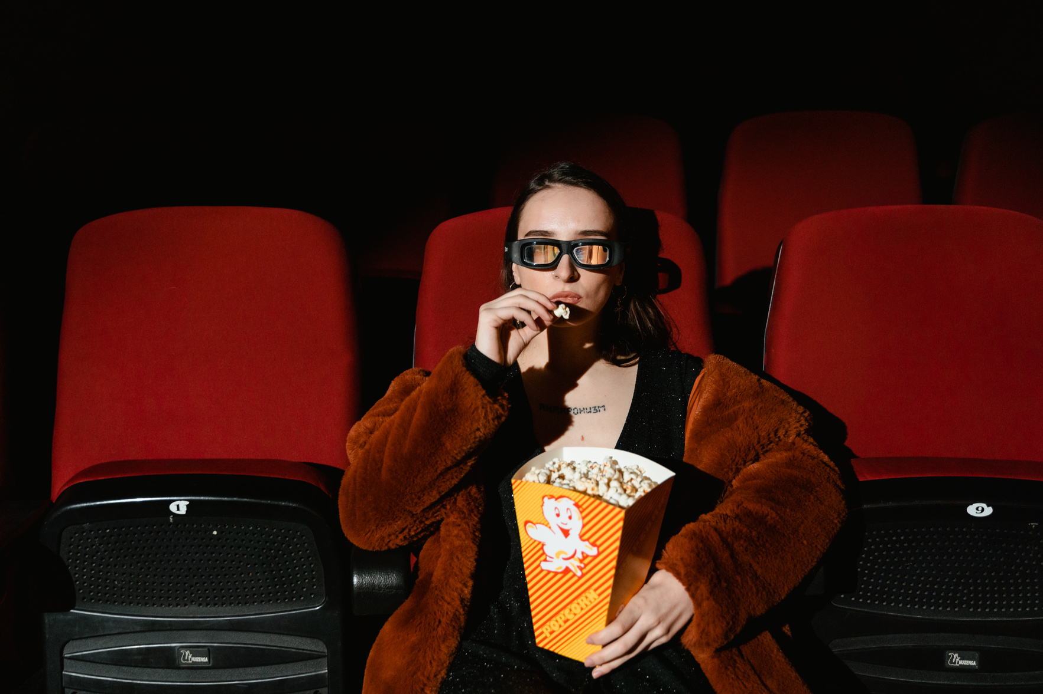
Home
About
Contact
BUSINESS UNDERSTANDING
Project goals:
Explore the different datasets showing the reviews, budgets and gross.
Find the type of films that perform well in the Box Office.
.Provide the head of the movie studio with information on which type of movies to create.
Once these goals have been met I will be able to identify the type of films tthat will generate a large revenue for the head of the new movie studio as they partake in this new venture.

Slide 4
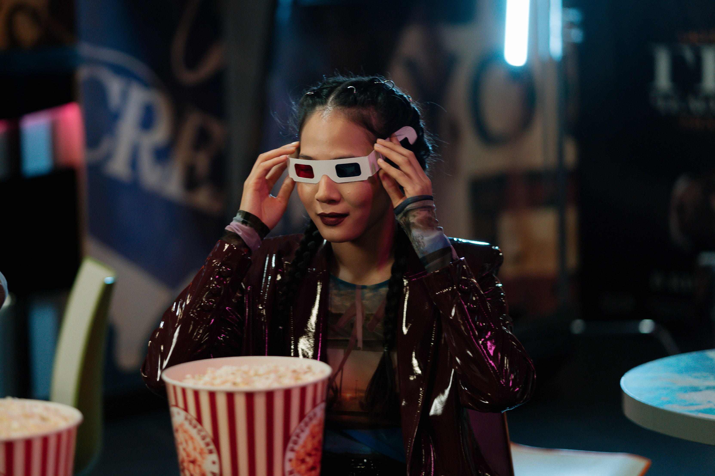
Liceria.Co
Home
About
Contact
DATA UNDERSTANDING
I accessed six datasets and decided to use two datasets the Box Office Mojo and the numbers dataset.
I cleaned both datasets and merged them together.
The dataset contained columns domestic gross, foreign gross and worldwide gross which i used to show the top grossing and lowest grossing movie titles.
I also used the worldwide gross and the production budget to create a column profit/loss to show which movies had the highest profit margins and the lowest profit margins.
I also displayed the trend in the years to show how the movie business has been growing and thriving for over a century.

Slide 5
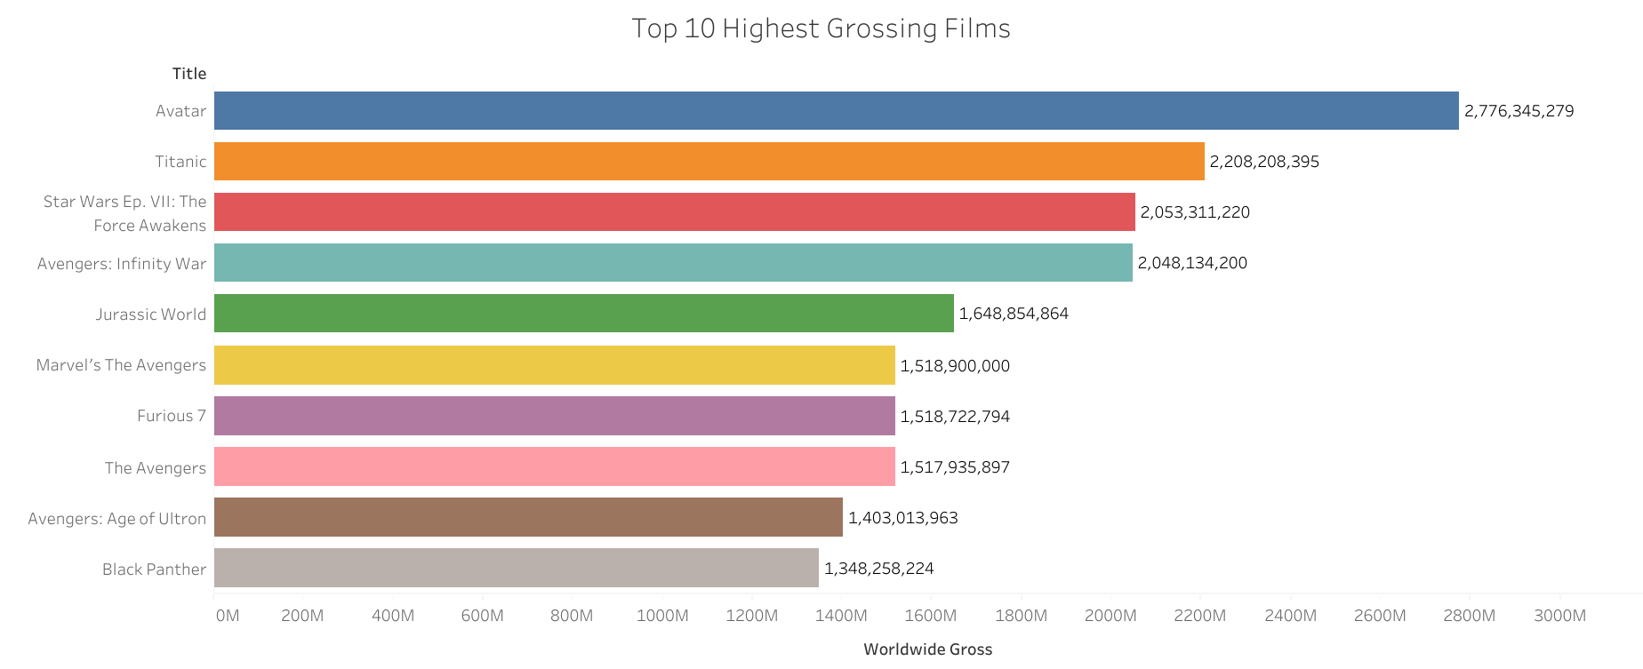
DATA VISUALIZATION
I am going to use visuals from tableau to communicate my insights on which movies the head of the new movie studio should create.
Avatar was the top grossing movie which is an Action/Sci-fi film.
Majority of the films that had a high revenue were Action films.

Slide 6
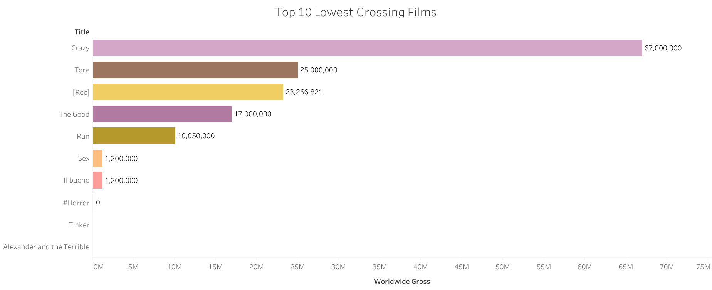
VISUALIZATION 2
The lowest grossing movies contains different types of films, so they might just have been bad movies as opposed to a specific genre of film performing badly at the box office

Slide 7
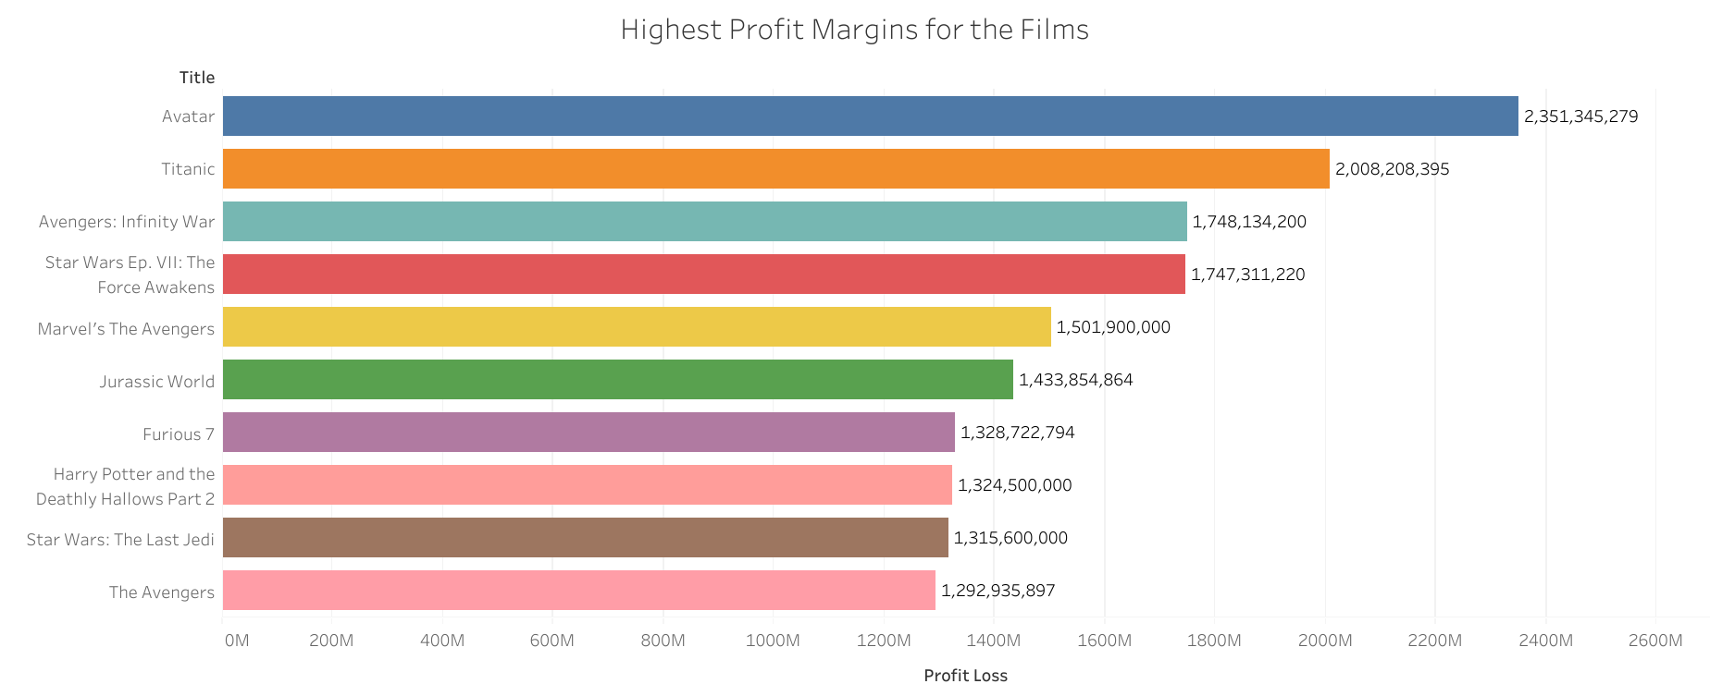

VISUALIZATION 3
Liceria.Co
Avatar was both the best selling movie and had the highest profit margin hence further collaborating that the head of the new movie studio should create action films.

Slide 8
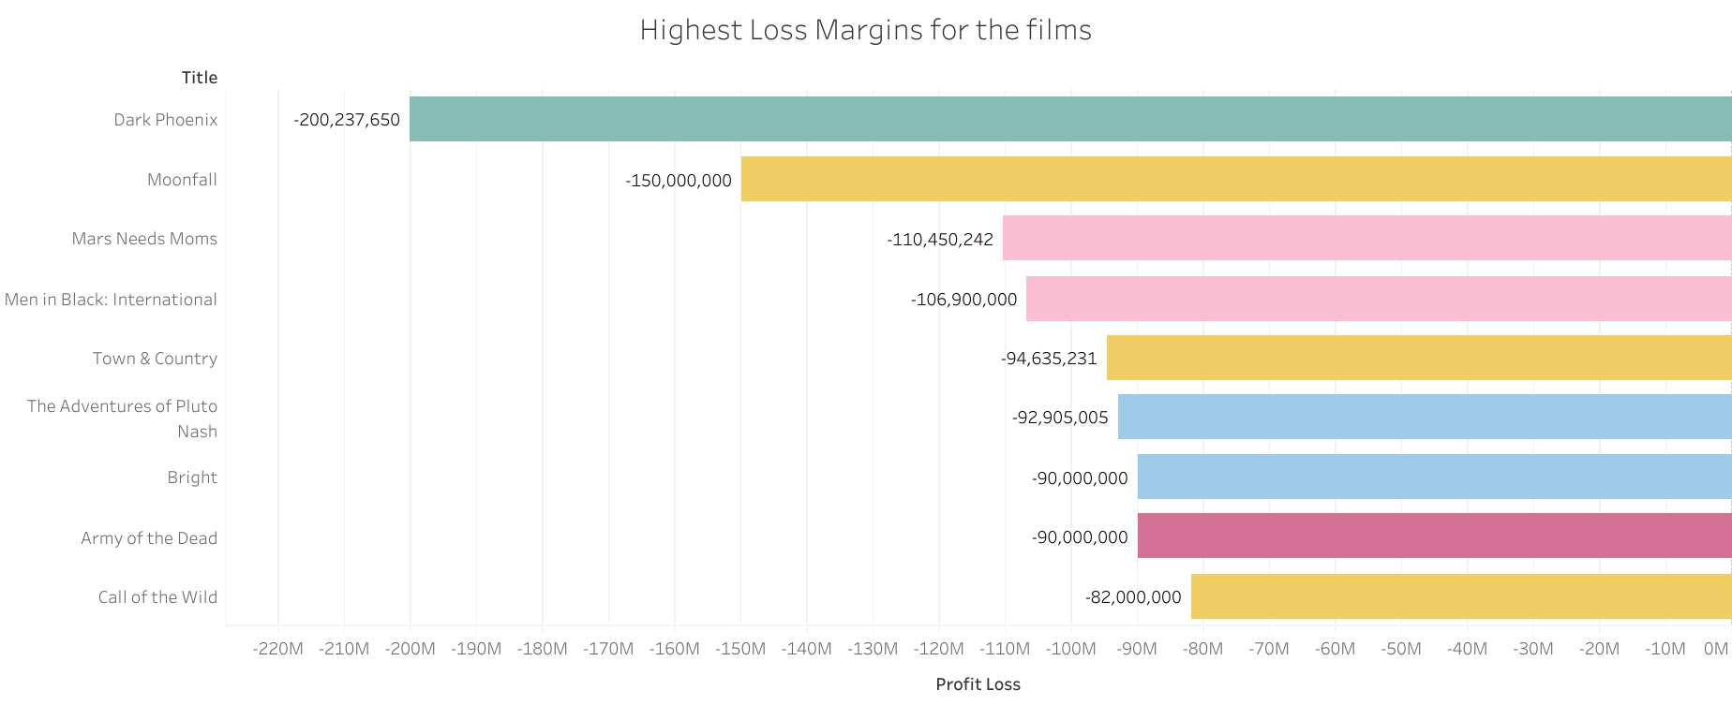
VISUALIZATION 4
Liceria.Co
The movie with the most losses is Dark Phoenix which is an Action film.
Majority of the films in the top 10 losses are Action movies so the head of the new movie studio needs to hire people who know what the audience wants.

Slide 9
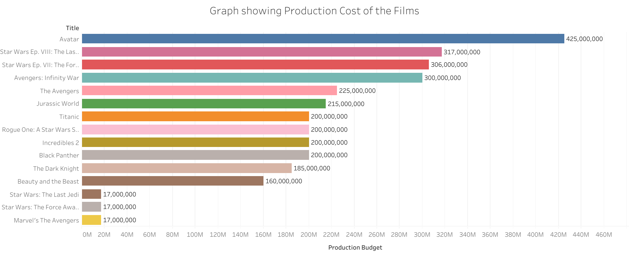
VISUALIZATION 5
Liceria.Co
Avatar had the highest production cost and the largest profit margin indicating that sometimes you’ve to spend money to make money.
Majority of the top 10 films had a high production cost.

Slide 10
CONCLUSION
Liceria.Co
The movies with the largest revenue at the Box office are Action/Sci-fi movies so the head of the new movie studio should create Action/Sci-fi films.
Creating movies sometimes requires a lot of capital so the head of the new movie studio should ensure they have the funding as they partake in this new venture.
The head of the new movie studio should research what the audience wants to see to avoid having a box office bomb like the Dark Phoenix movie , meaning they should have good writers and directors at their disposal.

Slide 11
RECOMMENDATIONS
Create Action/Sci-fi movie since they generate high revenue and have large profit margins.
Diversify and create Romance and Fantasy movies since they also perform well at the box office like the Titanic movie.
Create high-budget films since some of the highest-grossing films had a big budget, as you might have a chance of making even more money by ensuring the quality of the movie is good as they say, high risk, high reward.
The head of the new movie studio should also be cost effective since some of the movies with low-budgets have performed well at the Box office.
Create low to mid-budget films because they're a new studio in the film industry.

Slide 12

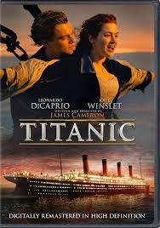

RECOMMENDATIONS
Images of the top 3 grossing movies.
LIGHTS, CAMERA, ACTION!

Slide 13
Home
About
Contact
2027 CINEMA PRESENTATION
THANK YOU
SEE YOU NEXT TIME

